Slide 1

Data55:
Richard, Anneke, Brendan,
Sara, Brenton, Saini and Aditya

Slide 2
Overview - Framework
AngularJS client side applications
Means one consistent language between client and server side
Node.js server side handling
Allows for easier manipulation of HTTP requests
Allows for development of a RESTful Web service
PostgreSQL (Postgres) database
Very similar to mySQL
Known for compatibility with angular and node

Slide 3
Overview - Stories assigned to Sprint
Student - Registration
Teacher - Registration
Student - Apply for Lessons
Teacher - Accept Student
Student - Get General Lesson Information
Manager - Add New Instruments
Student - Hire Instrument
Manager - Mark Instruments Returned
Manager - View Instrument Hire Requests

Slide 4
Overview - Stories Status
Untouched | In Progress/Almost Finished | Finished/Testing
 |  | Student Registration
 |  | Teacher Registration
 | Student Lesson Application
 | Accept Student
 | Lesson Information Page
 |  | Add New Instruments
 | Student Hire Instrument
Manager Inst. Hire requests
Student Specific Teacher

Slide 5
Overview - Time Management & Issues encountered
New tools and languages
No login user story
Not everyone understands the system architecture yet
Not everyone is familiar with GitHub
Misunderstandings of user story (Get Lesson Info)
These issues resulted in additional time being spent on all tasks, as well as existing user stories needing to be delayed for more important ones.

Slide 6
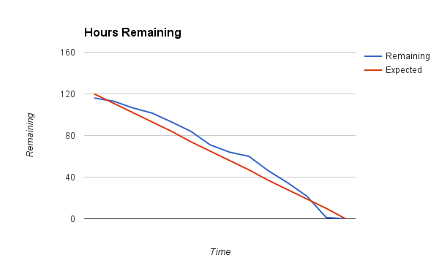
Overview - Hour Burndown Chart

Slide 7
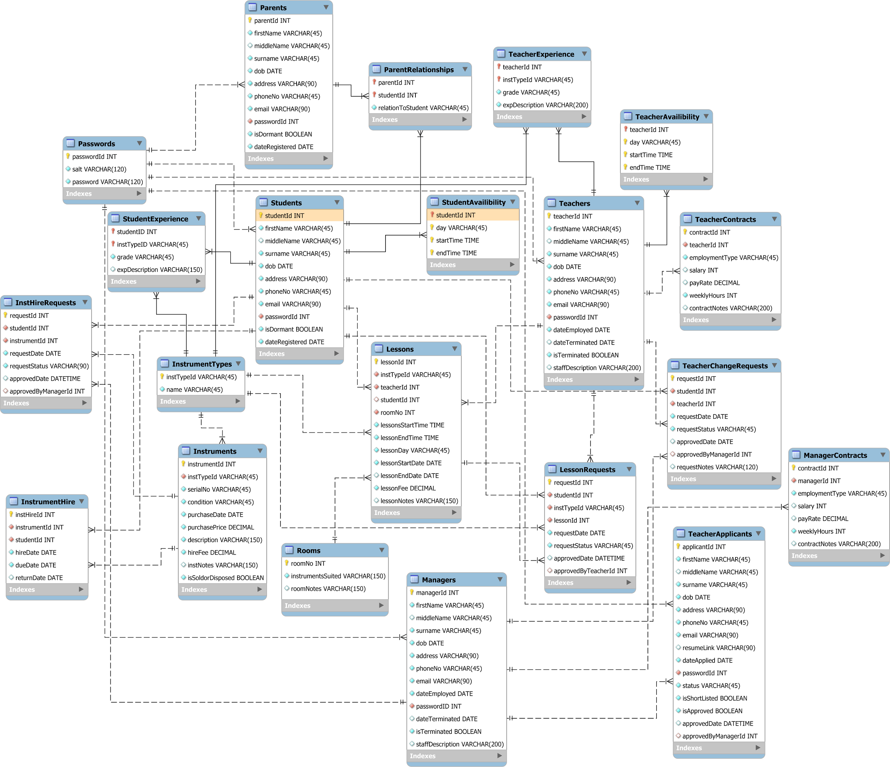
Overview -
Music School ERD
MySQL →
PostgreSQL
Database

Slide 8
Stories: Student Registration (AALV-60)
Done:
Created Database Tables and Queries
Created Frontend Page
Added Validation
Created Service to manage registration
To do:
Email services
Test to ensure no errors or bugs
Merge Template with Application
Acceptance Criteria:
Create account
Enter personal details (name, dob, address)
Able to successfully register
Email validation

Slide 9
Stories: Teacher Registration (AALV-27)
Done:
Created Database Tables and Queries
Created Frontend Page
Added Validation
Created Service to manage registration
To do:
Email services
Test to ensure no errors or bugs
Merge Template with Application
Acceptance Criteria:
Able to enter general details - Name, email, phone, address
Able to create account if details are given produces error if not
Email account details to teacher with temp password that needs to be changed on first login
Teacher account can log in after creation
Teacher prompted to change password on login

Slide 10
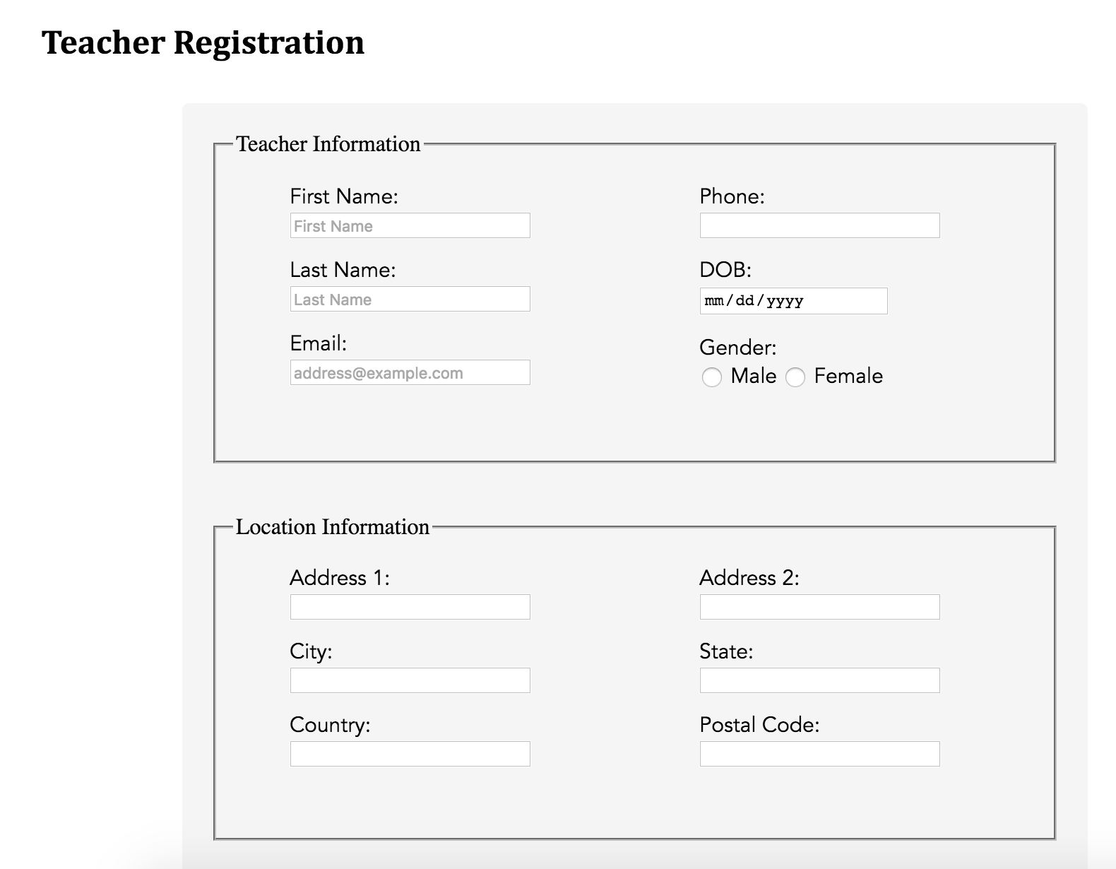
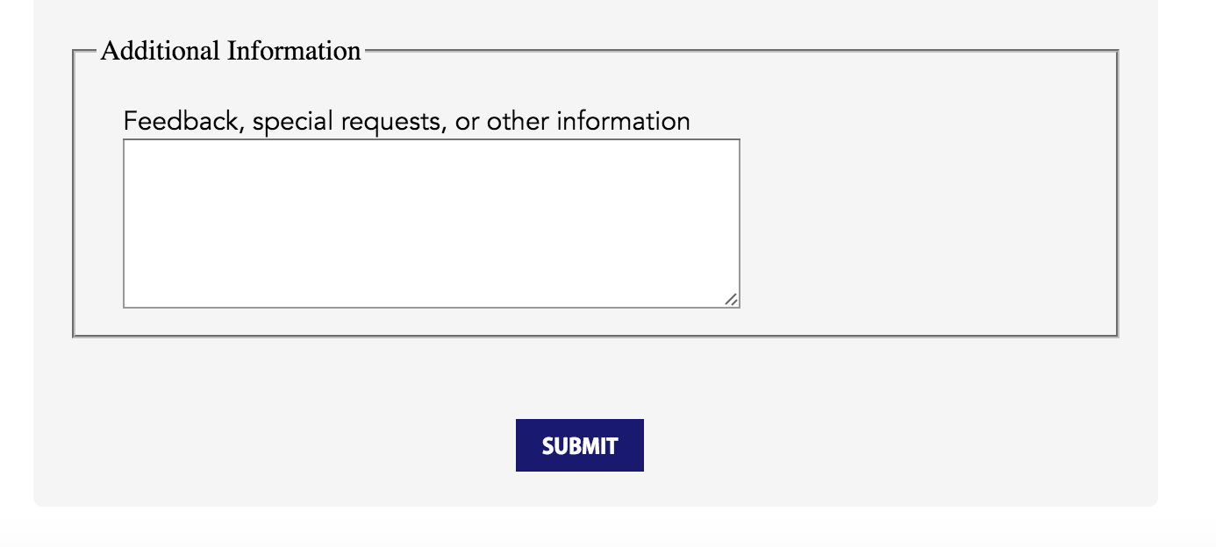
Stories: Teacher Registration (AALV-27)

Slide 11
Stories: Student Lesson Application (AALV-11)
Done:
Created Database Tables and Queries
Created Frontend Page
Added Validation
Created Service to manage registration
To do:
Style Confirmation Page
Email services
Test to ensure no errors or bugs
Merge Template with Application
Acceptance Criteria:
Limited to 1 lesson if new, up to 3 if coming back
Validation on data entered
Either BYO instrument or hire from school (must be one of the two)
Enter approximate instrument experience
Times for lesson
Recurring?
Payment Method
Instrument
Teacher
Available times

Slide 12
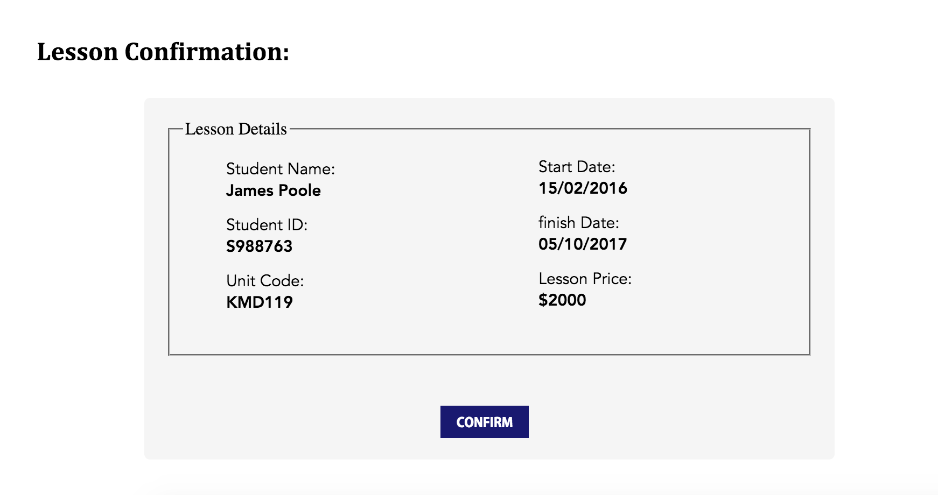
Stories: Student Lesson Application (AALV-11)

Slide 13
Stories: Teacher Accept Student (AALV-61)
Done:
Created Database Tables and Queries
Created Frontend Page
To do:
Add Validation
Create Service
Test to ensure no errors or bugs
Merge Template with Application
Acceptance Criteria:
Able to view students who want to be taught by the teacher.
Able to accept the student
If accepted, time gets booked in teacher + student's schedules
Student and Management gets notified
Able to decline the student (with reason)
if declined, student is informed if they specifically requested the teacher
if declined, management is informed and sent the reason
teach request gets sent to another teacher.

Slide 14
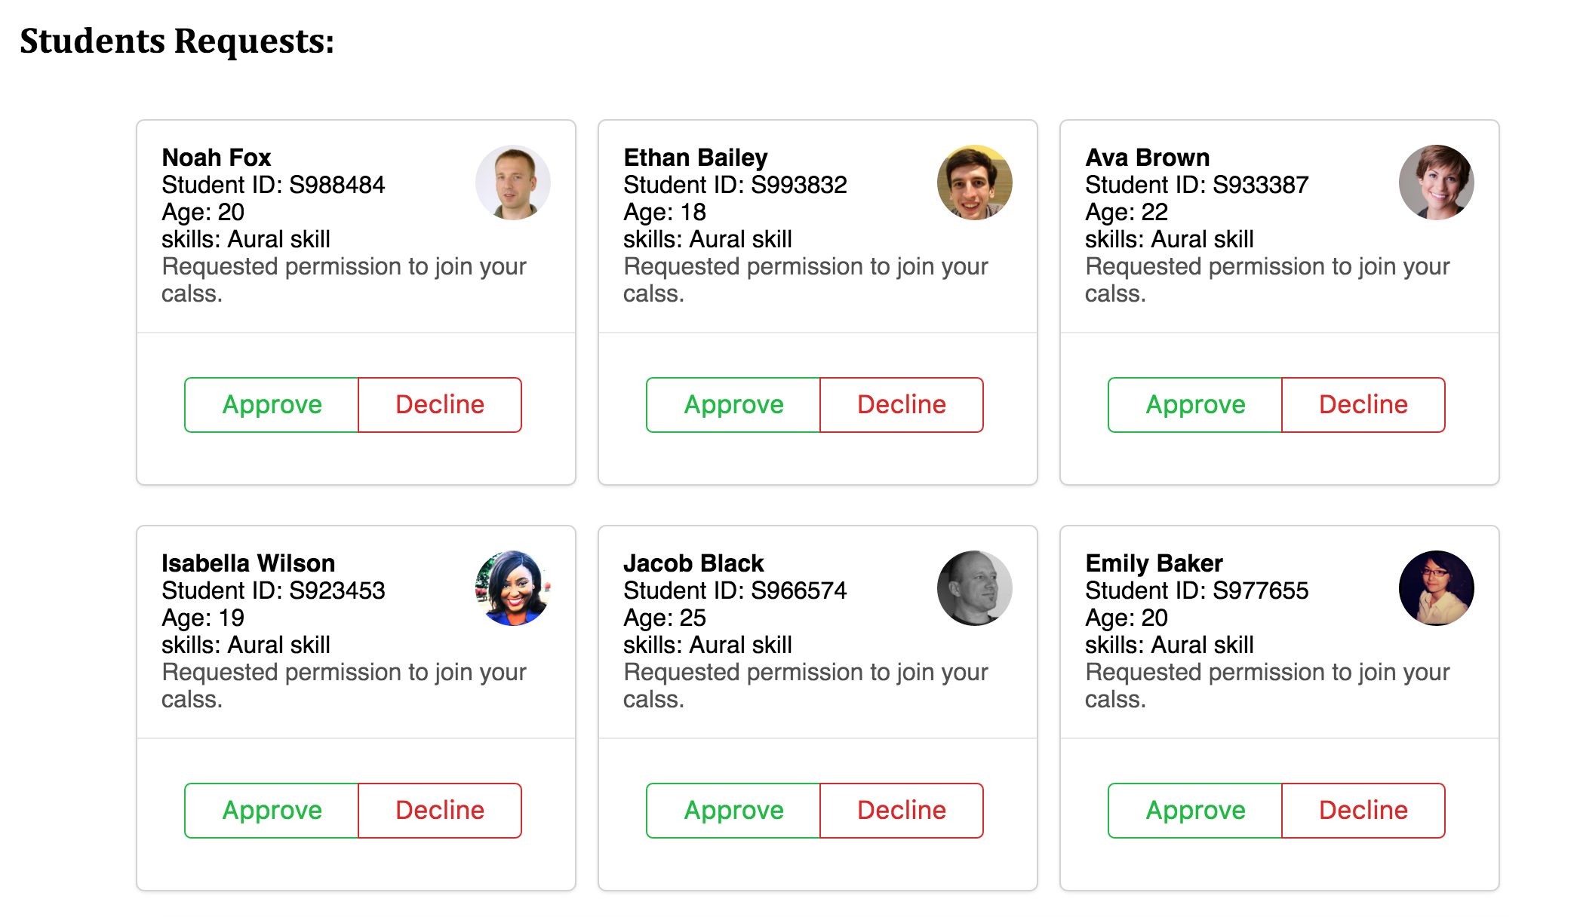
Stories: Teacher Accept Student (AALV-61)

Slide 15
Stories: Student Get Lesson Info (AALV-58)
Done:
Created Frontend Page
Wrote Content
To do:
Style Page
Acceptance Criteria:
List of instruments taught at school
Amount of spaces available for each instrument
Times of lessons
Teachers available

Slide 16
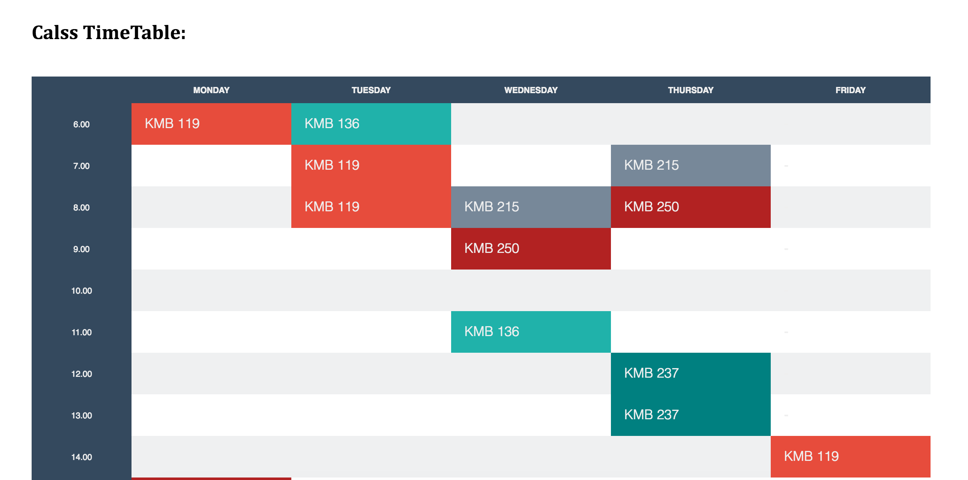
Stories: Student Get Lesson Info (AALV-58)

Slide 17
Stories: Add New Instruments (AALV-37)
Done:
Created Database Tables
Created Frontend Page
Add Validation
Create Service
To do:
Testing
Acceptance Criteria:
Add new instruments
Type, condition
Each instrument should have a unique code
New instruments should show up on view

Slide 18
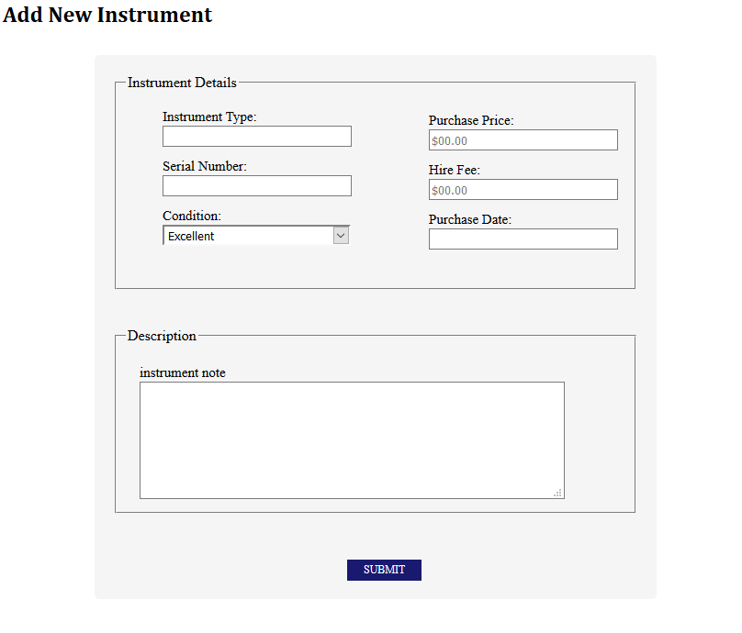
Stories: Add New Instruments (AALV-37)

Slide 19
Stories: Hire Instruments (AALV-14)
Done:
Created Database Tables
Created Frontend Page
Created Slot in lesson application
To do:
Create Service
Testing
Acceptance Criteria:
Instrument Filtering for a specific instrument
Can't request a borrowed or broken instrument
Must specify length of time
Must specify payment method
Once requested, other students are unable to put in a request for the same instrument.

Slide 20
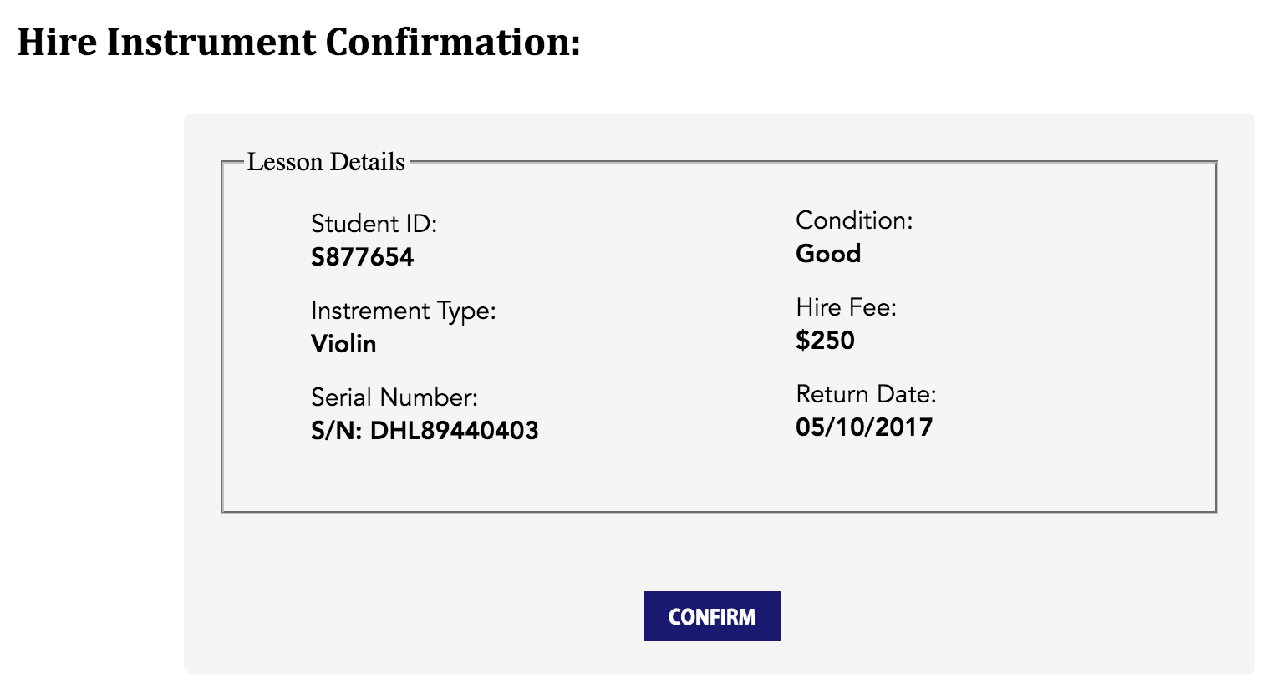
Stories: Hire Instruments (AALV-14)

Slide 21
Stories: Return Instruments (AALV-35)
Done:
Created Database Tables
To do:
Create Page
Create Service
Testing
Acceptance Criteria:
Shows hired out instruments list
Various filters (by date out, by due date, type) default ID
Can mark as returned
Returned instruments show up in the available instrument view
Notify the student that it has been processed

Slide 22
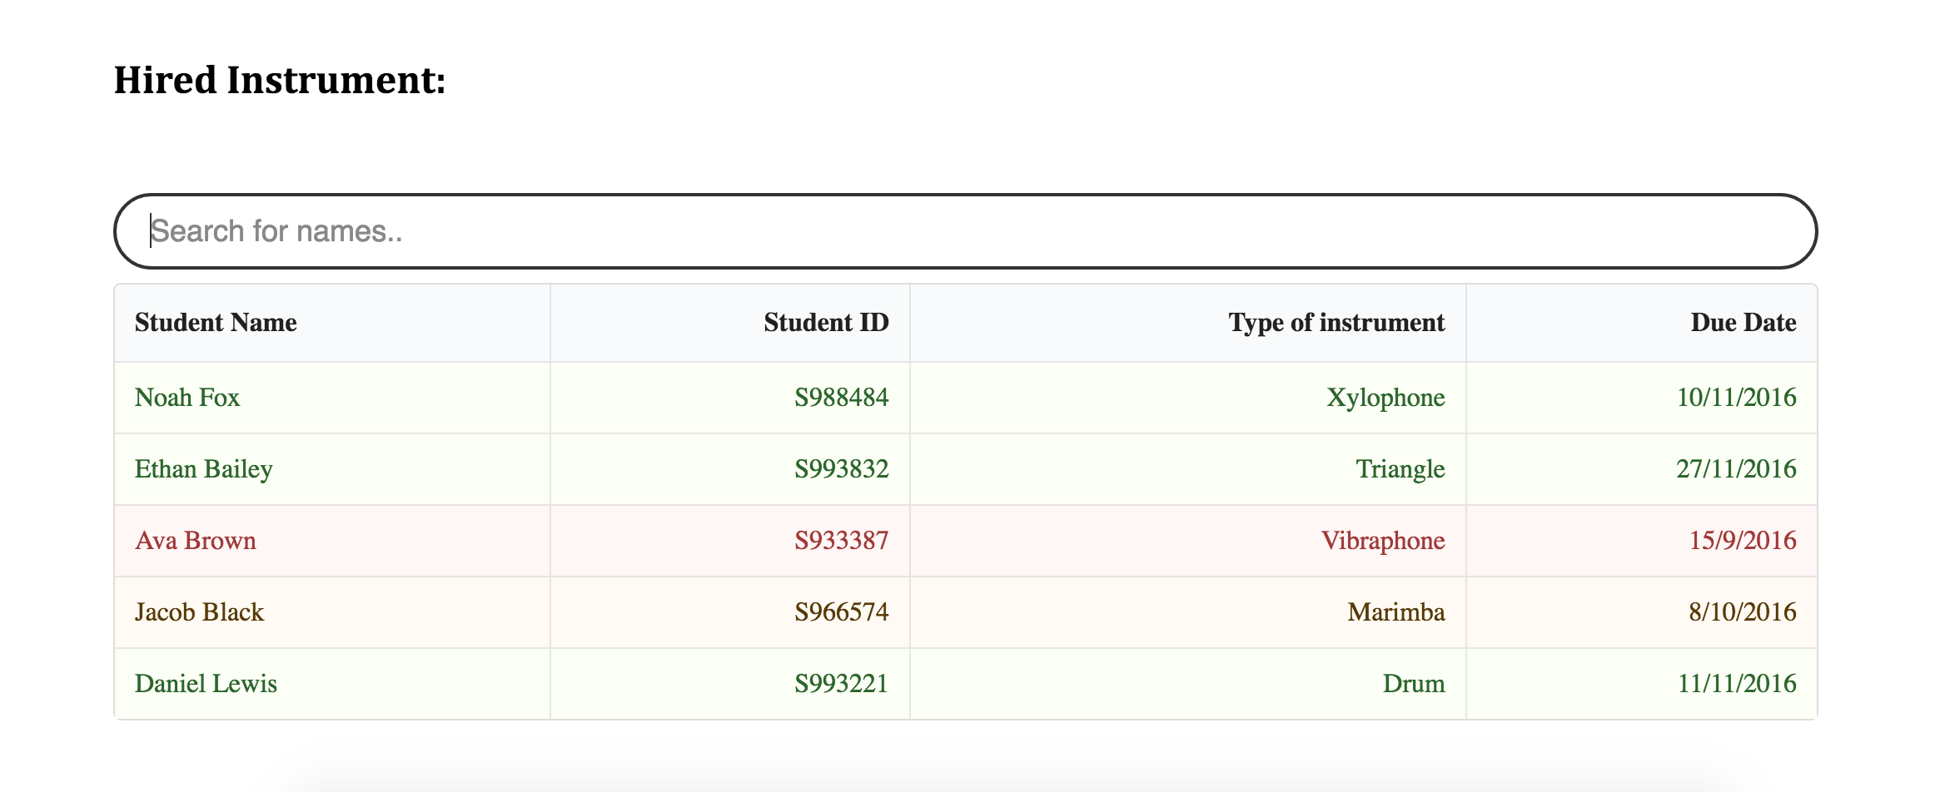
Stories: Return Instruments (AALV-35)

Slide 23
Stories: View Hire Requests (AALV-32)
Done:
Created Database Tables
Create Page
To do:
Create Service
Testing
Acceptance Criteria:
Various filters (newest request, student asking, type)
Ability to accept or deny requests
If denied, must give reason
Ability to specify an instrument to give the student or assign randomly.
Student is informed
Once instrument is assigned to a student, it must be marked as hired

Slide 24
Stories: Request Specific Teacher (AALV-12)
Done:
Created Database Tables
Create Page
To do:
Create Service
Testing
Acceptance Criteria:
Assign prefered teacher in the class registration page
Request is considered/sent to that teacher first

Slide 25
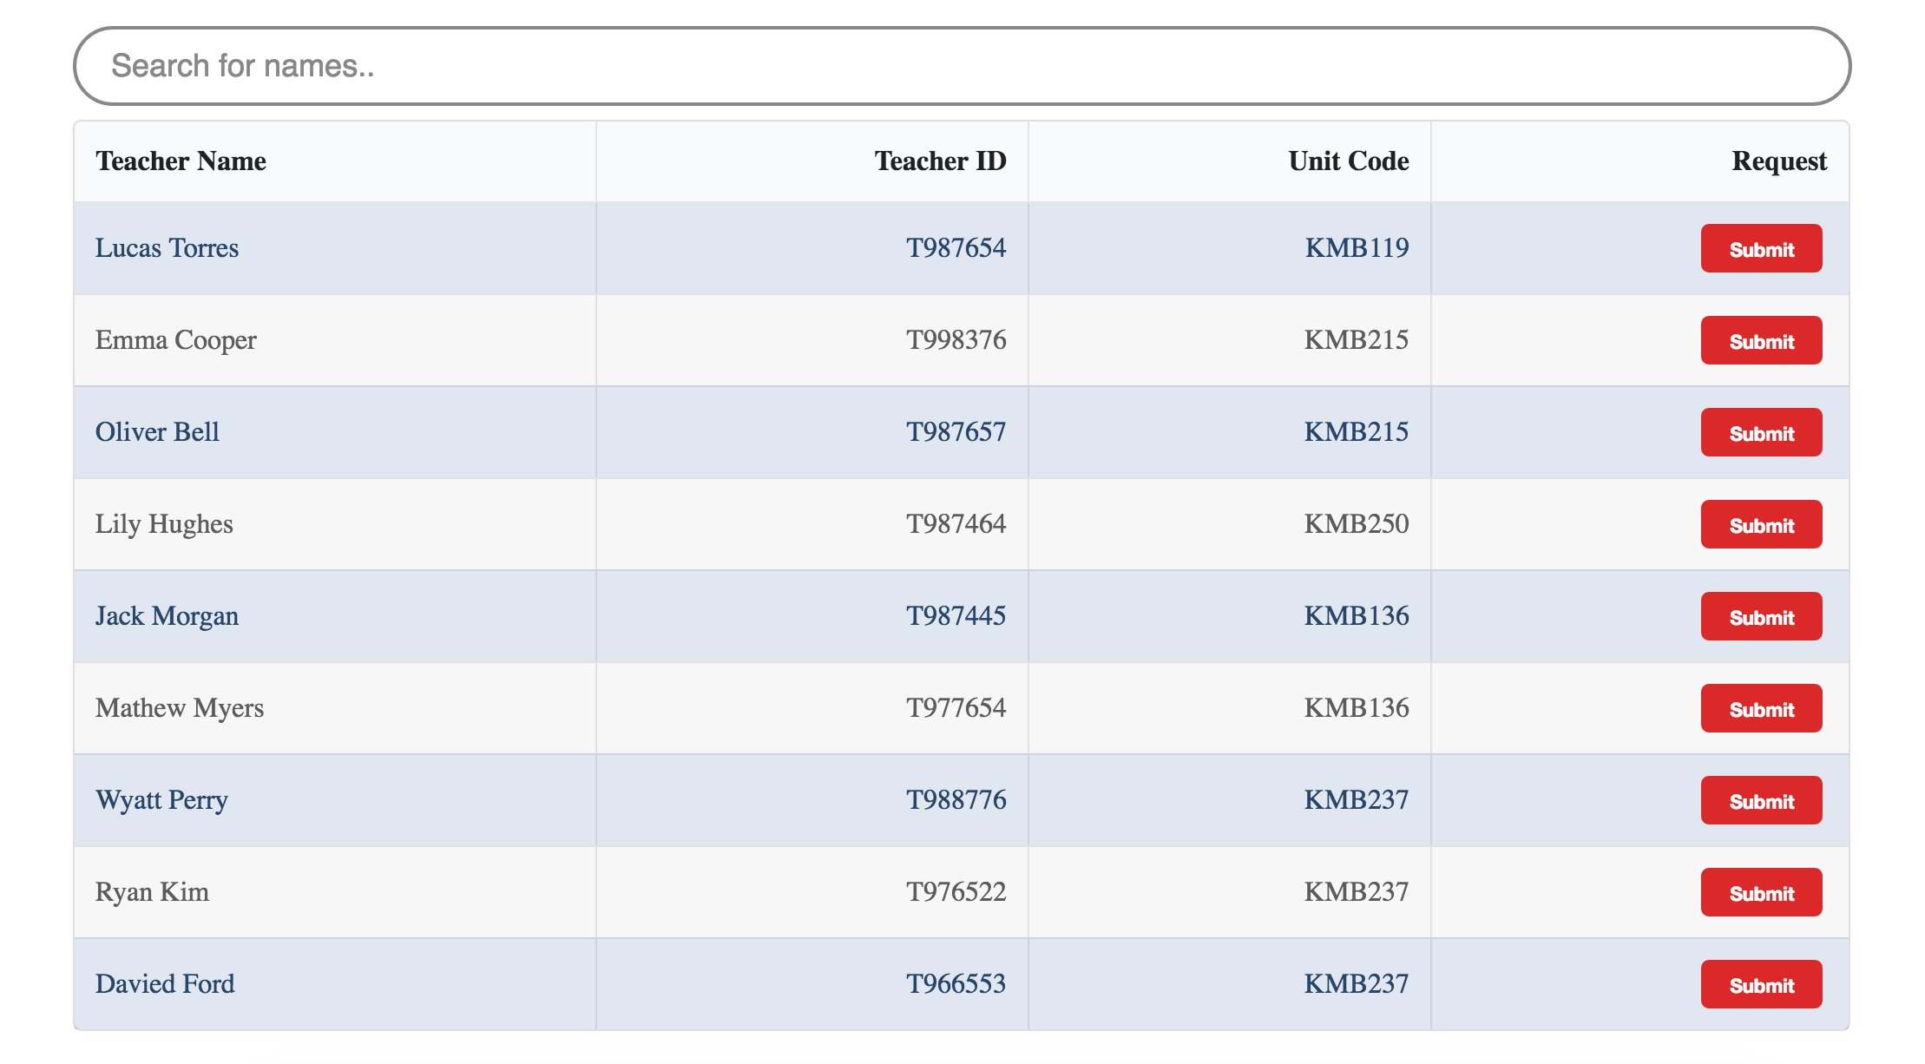
Stories: Request Specific Teacher (AALV-12)

